Slide 1
Gen AI Orchestrator for Email and Document Triage/Routing
Team Name : Sandesh
Team Member : Ananthoju Vajreshwar ,Saurabh Dhakate ,Ankush Virulkar
Date : 03/21/2025 – 03/26/2025

Slide 2
Problem Statement
There is significant volume of serving requests through the emails. Thease email contain diverse request,ofen with attachment and will be ingected to servicing platform and create service request whill will go through the workflow processing.Incomming service request(SR) via e-mail require a manual triage where “Gatekeeper” who :
Read interpreted the email contain and attachment.
Identify the intent of the email and classify the “request type” and “Sub request type”
Extract key attribute for populating in service request
Assign the request to the appropriate team or individual based on role and skill.
The manual triage process require a team of gate keeps and time consuming. Sometime its inefficient and error prone when volume is large.
The volume is to automate email classification and data extraction using Gen AI (LLMs), improving efficience, accuracy and turnaround time, Also minimize the gatekeeper activity.

Slide 3
Solution Overview
we are using the SDCA (Stochastic Dual Coordinate Ascent) Maximum Entropy classifier, which is a multiclass classification algorithm
Stochastic Dual Coordinate Ascent (SDCA)
SDCA is an optimization algorithm used for training linear classifiers, often applied in logistic regression and SVM models. It is highly efficient for large-scale datasets due to its ability to solve dual optimization problems.
Why SDCA for Email & Document Classification?
Fast Convergence: Efficient in handling large email/document datasets.
Scalability: Works well with high-dimensional features extracted from text data.
Regularization: Helps in avoiding overfitting when training classifiers.
How SDCA Works?
It optimizes the dual formulation of the problem by iteratively updating a small number of dual variables.
Uses a stochastic approach, meaning it selects a subset of data at each iteration rather than using the entire dataset.
Well-suited for sparse data, which is common in NLP applications.

Slide 4
How It Works
Step-by-Step Process:
Email/Document Ingestion: Captures emails and files from multiple sources.
AI-Powered Classification: Uses Gen AI models to analyze and categorize content.
Intelligent Routing: Directs documents to the right department/person based on predefined rules.
Feedback Loop: Continuous learning to improve accuracy over time.

Slide 5
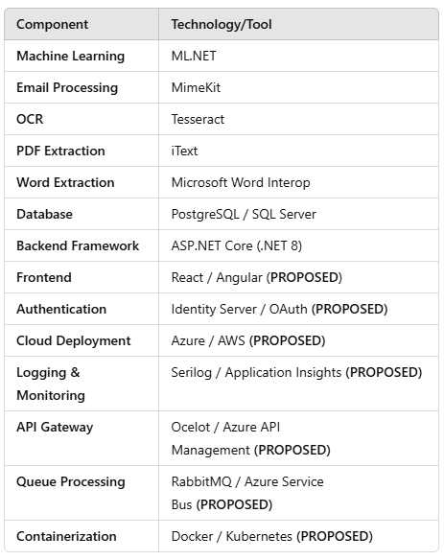
Tech stack and Packages used

Slide 6
Benefit and impact
🔹 Time-Saving: Automates manual email sorting 🔹 Accuracy: Reduces misclassification 🔹 Scalability: Handles high-volume emails 🔹 Improved Customer Support
- 80-90% classification accuracy
- 50% reduction in response time

Slide 7
Future Enhancements
Multi-Language Support
Adaptive Learning** (Model improving over time)
Integration with Enterprise CRM & Ticketing Systems
Voice-to-Email Classification

Slide 8
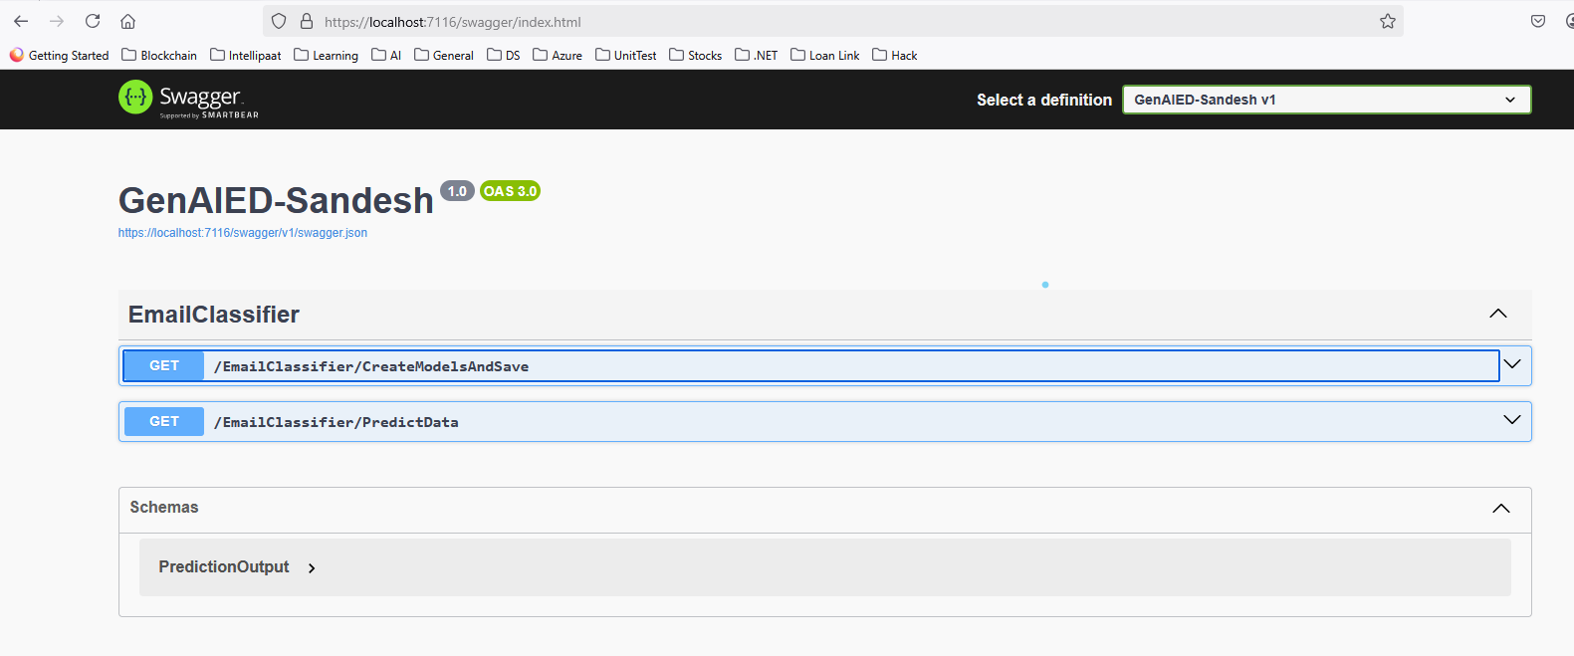
API Endpoints

Slide 9
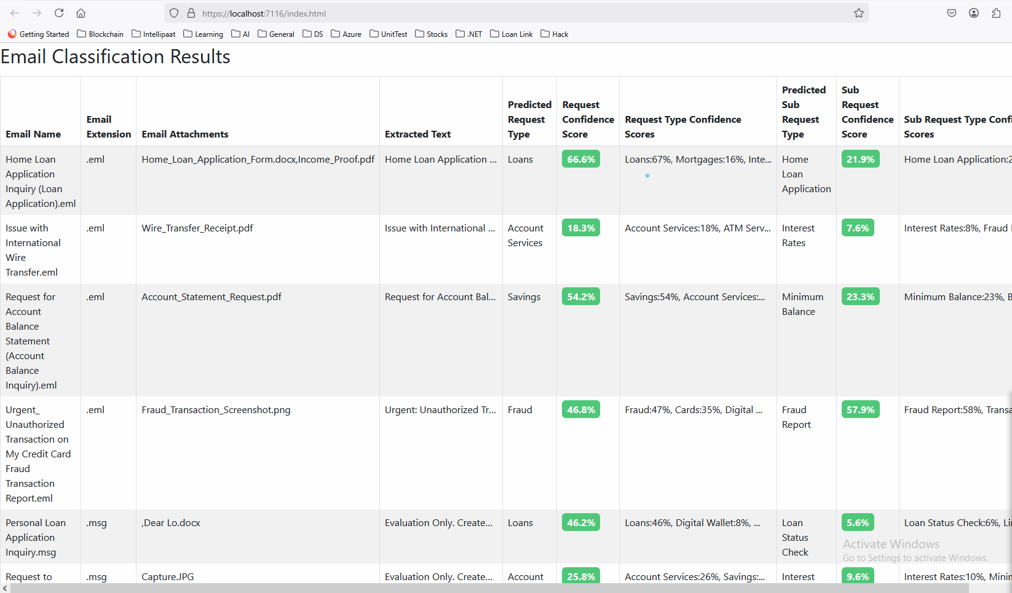

Slide 10
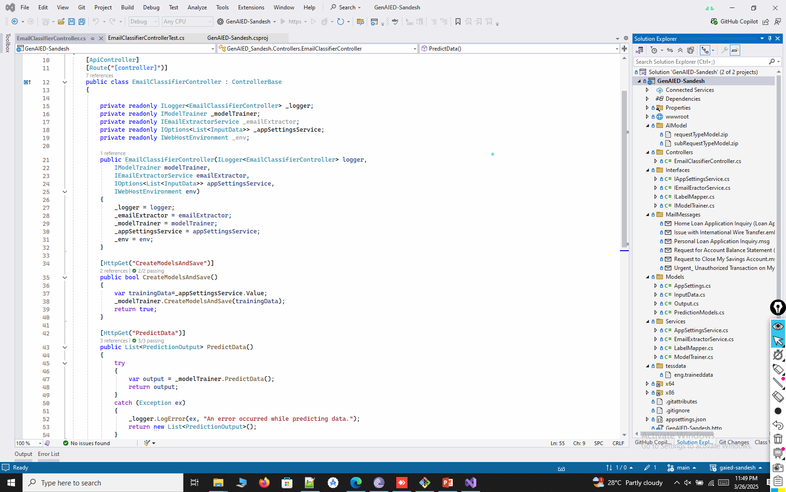

Slide 11
Thank you
Contact:
Vajreshwar.Ananthouju@wellsfargo.com
saurabh.dhakate@wellsfargo.com
Ankush.Virulkar@wellsfargo.com
GitHub Repo: https://github.com/ewfx/gaied-sandesh/tree/main

